Slide 1
Cyclistic Bike-share
June 24, 2022
Presented by Yunna Pudnik

Slide 2

Contents
Introduction
Data Insights
Summary
Recommendations

Slide 3
Business task
Understand the difference of using Cyclistic bikes between annual members and casual riders.
The result of the analysis will be used by the marketing department to aim and convert casual riders into members.

Slide 4
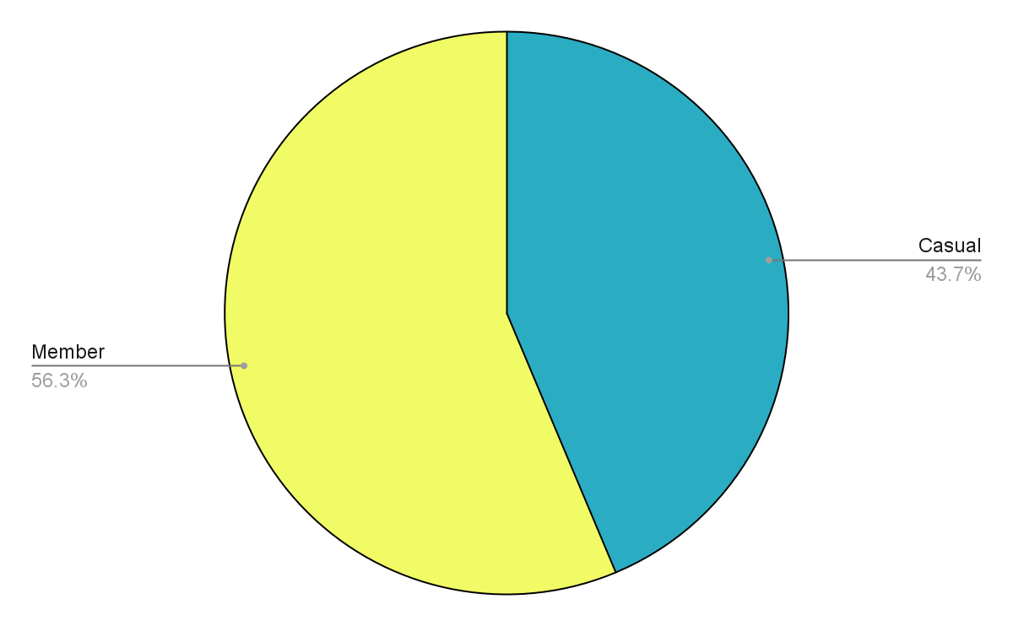
Total rides divided by user group
Insight №1
Number of rides taken by Members is 12,6% more then rides taken by Casual riders.

Slide 5
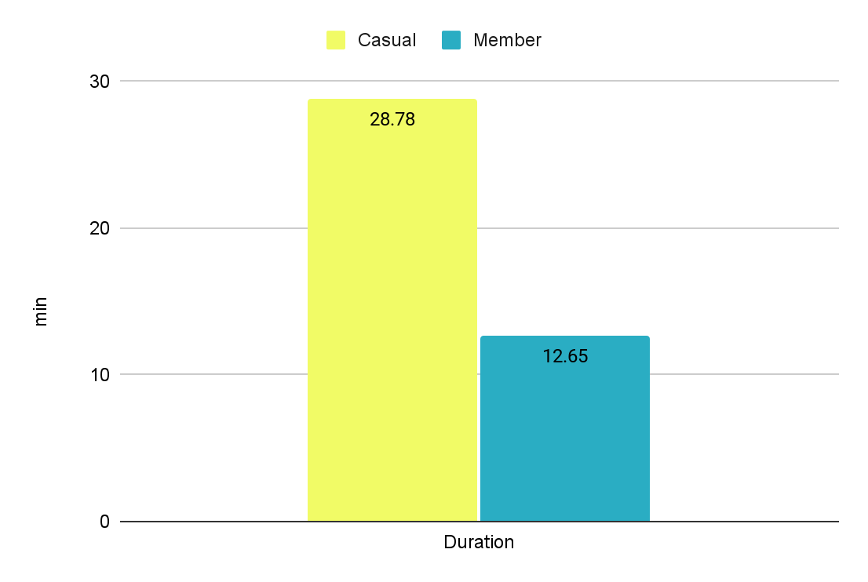
Average ride’s duration by membership type
Average ride duration of Casual riders is more then 2 times higher compare to Member riders

Slide 6
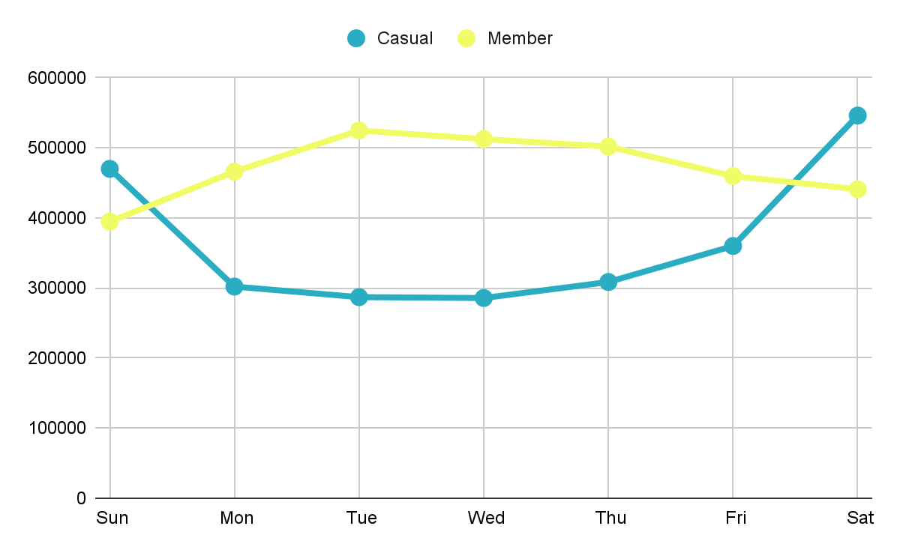
Weekly number of rides
Insight №2
Casual riders make almost twice more rides on weekend compare to weekdays.
Member’s rides increase during weekdays.

Slide 7
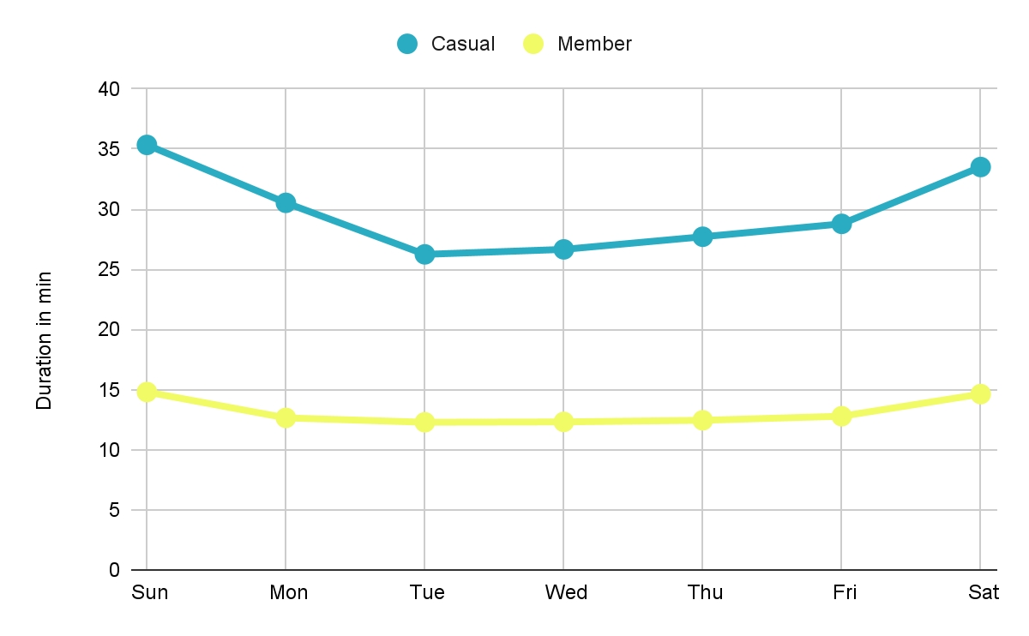
Average ride duration by day of the week
Insight №3
Member’s ride duration remains steady throughout the week.
While Casual’s ride duration increases by the weekend.

Slide 8
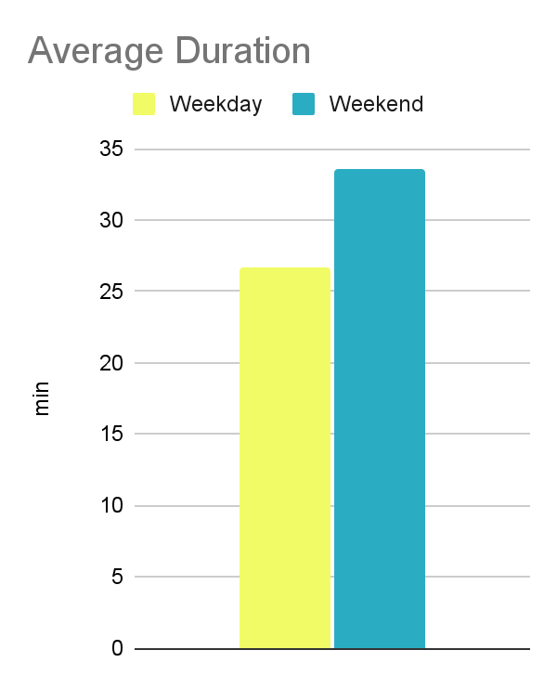
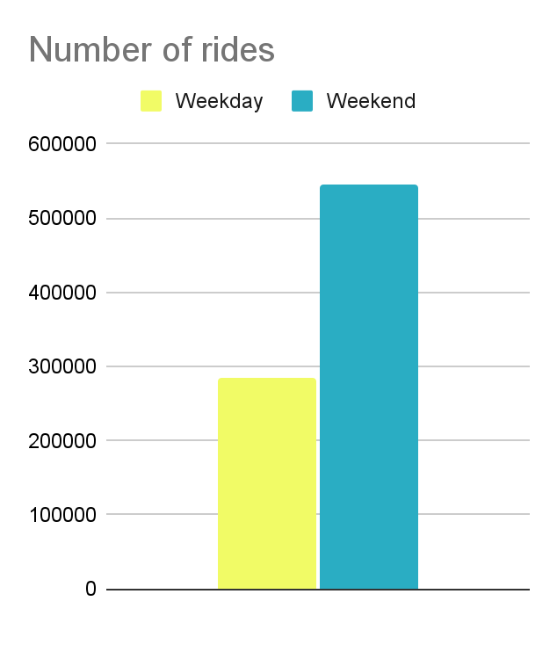
Casual riders Weekday vs Weekend
Correlation shows that Casual riders tend to make longer rides on Weekends than on Weekdays.
And more number of rides on Weekends than on Weekdays.

Slide 9
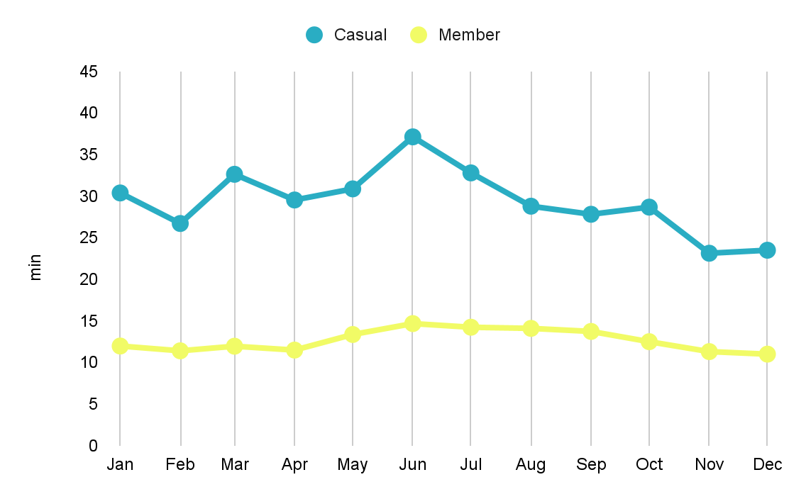
Annual average ride duration last 12 months
Insight №4
Average ride duration of Casual users increases by summer and hits its peak on June.

Slide 10
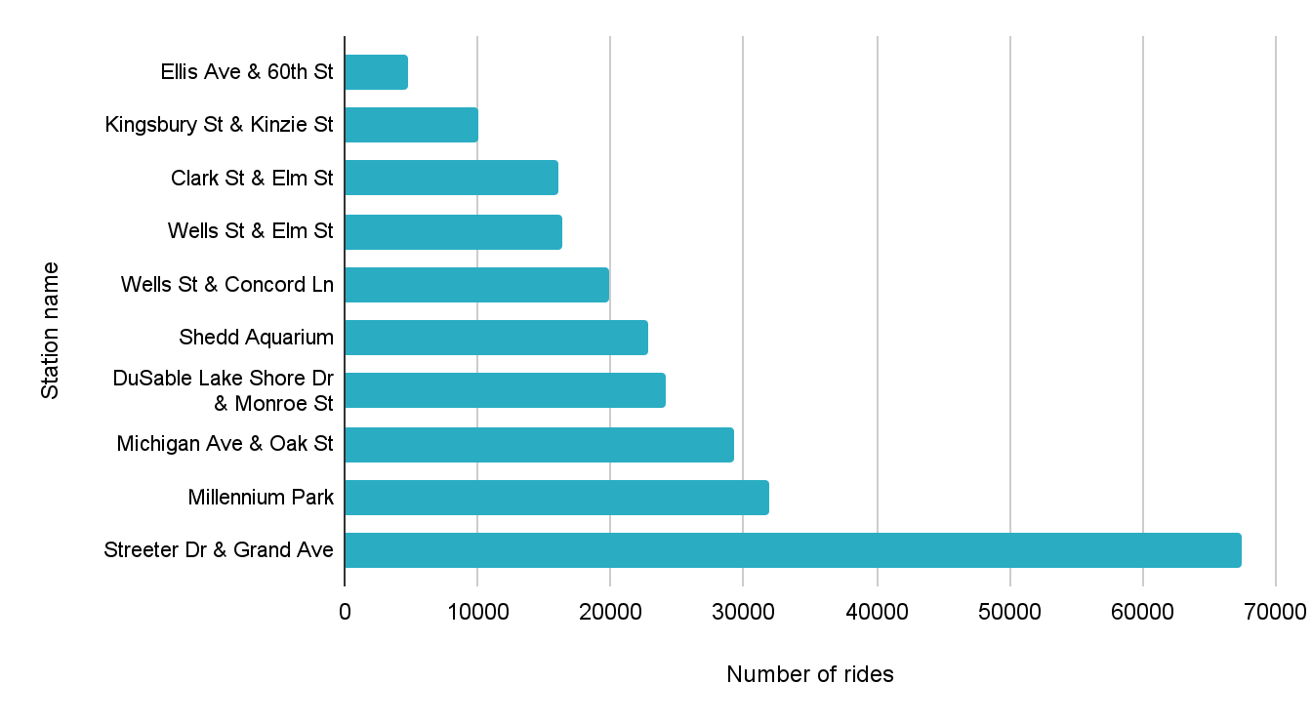
Top 10 stations used by Casual riders
Insight №5
The most popular starting station has 67386 bike pick ups among Casual riders.

Slide 11
Summary
Casual riders take 12,6% less rides then Members, but average ride has longer duration.
Casual riders mostly use bikes for entertaining purposes. While Members have constant activity throughout a year, Casual riders use bike on weekends and holidays.
Casual riders make longest rides in March, June and July. In peak month July the duration of Casual ride is 3 times longer then Member ride.
Casual riders are more active on Weekends and tend to take longer rides. 7 mins increase in duration of rides and 260,358 increase in number of rides.

Slide 12
Recommendations
Now we know how Casual riders differ, we can state some suggestions:
Set promotion in busiest stations by targeting casual riders.
Days: weekends; Month: March, June, July; Stations: Streeter Dr & Grand Ave, Millennium Park, Michigan Ave & Oak St
Keep annual membership promotion linked to entertaining activities, weekends content and summer events.
Design special seasonal packages for Casual riders, which will encourage them to take longer rides and increase revenue.

Slide 13
Thank you!

